Slide 1
Diabetes Prediction Model Report
Notes:
Hello everyone, today we will present the research findings on our diabetes prediction models.

Slide 2
Contents
01
Introduction
02
Data Visualization
03
SVM Model
04
Random Forest
05
Discussion
Notes:
First, let's take a look at today's agenda. We will start with the background introduction, then introduce the models we used, and finally have a discussion.

Slide 3
01
Introduction
Notes:
To better understand our model, let's first look at the background of diabetes.

Slide 4
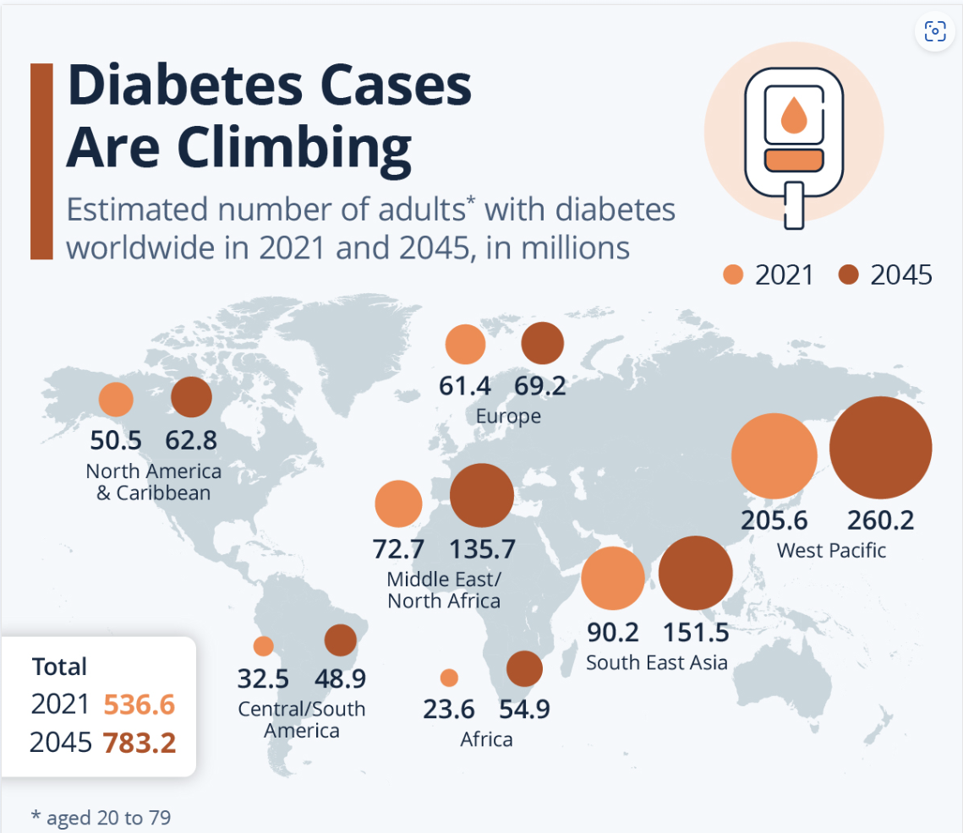
Background Introduction
Diabetes is a major global public health issue affecting millions worldwide.
Early prediction and intervention are crucial for reducing the incidence and complications of diabetes.
Notes:
To better understand our model, let's first look at the background of diabetes.

Slide 5
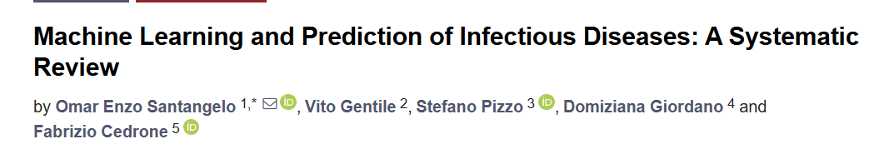


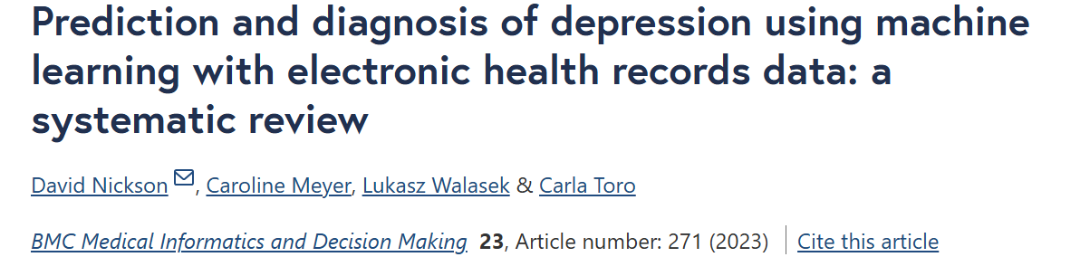
Application of Machine Learning in the Medical Field
In recent years, the application of machine learning techniques in the medical field has rapidly developed.
Many studies have shown that machine learning models can be effectively used for disease prediction.
Notes:
In the face of such a severe situation, we need more effective tools to tackle the challenges of diabetes. Machine learning has a wide range of applications in medical prediction. It can help us predict diseases more accurately, improve diagnostic efficiency, and develop personalized treatment plans. For example, machine learning algorithms have been used to predict various diseases such as heart disease, cancer, and diabetes.

Slide 6
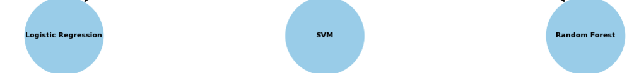
Model Descriptions
Logistic Regression: Simple to implement and interpret, provides probability outputs, efficient for large datasets.
SVM: Resist overfitting, can handle non-linear data with different kernel functions.
Random Forest: Offer high accuracy, reduce overfitting through randomization, handle missing values while providing feature importance insights
Notes:
Among the many models, we ultimately chose logistic regression, support vector machine (SVM), and random forest. These models perform excellently in handling classification problems and have high accuracy and stability. Logistic regression is simple and easy to use, suitable for binary classification problems; SVM performs well in high-dimensional spaces, suitable for complex datasets; and random forest improves model robustness and accuracy through ensemble learning.

Slide 7
02
Data Visualization
Notes:
This study uses a dataset from Kaggle, originating from the Behavioral Risk Factor Surveillance System (BRFSS), a health-related telephone survey collected annually by the Centers for Disease Control and Prevention (CDC) Next, I will hand over to my teammate, who will provide a detailed introduction to the data we used and the data analysis process.

Slide 8
Exploratory Data Analysis
Identifying and addressing missing values, outliers, and inconsistencies within the dataset.
1
Data Cleaning
2
Feature Exploration
Examining key variables related to diabetes, such as age, BMI, High Cholesterol, High Blood Pressure, Smoking, Alcohol Consumption and Physical Activity
3
Data Visualisation
Creating graphs and charts to reveal relationships and patterns in the data.

Slide 9
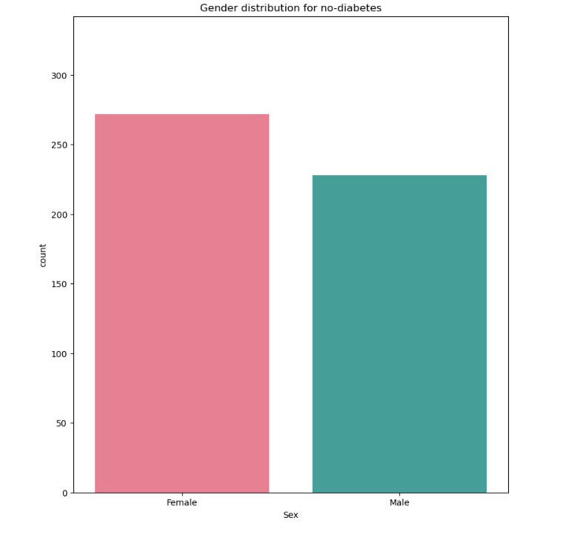
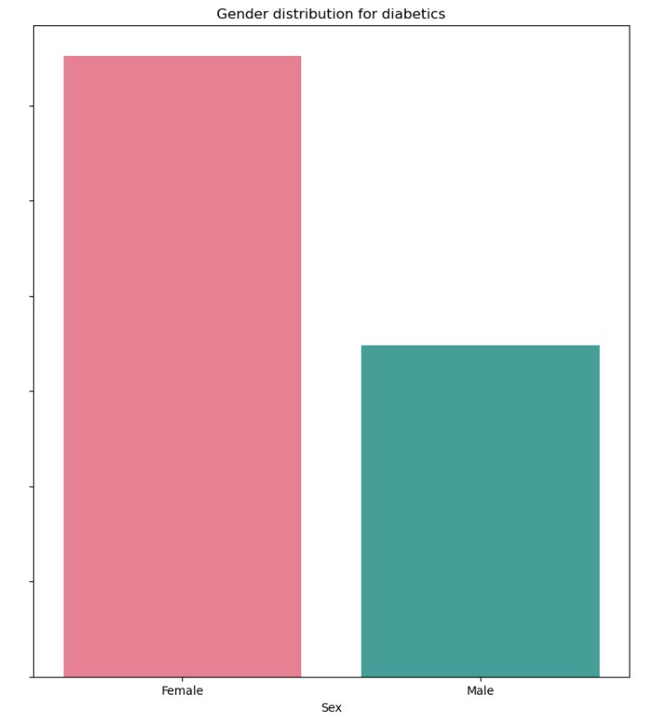
Discover Gender Distribution
Gender distribution for no-diabetes
Gender distribution for diabetics
Both females and males are vulnerable to diabetes

Slide 10
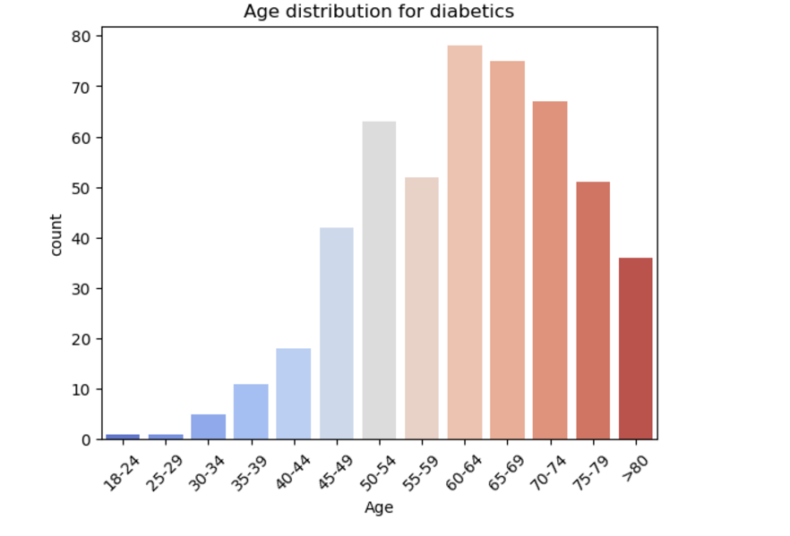
Age Distribution for People with Diabetes
Three age groups, 60-64, 65-70, and 70-74, are more likely to have diabetes

Slide 11
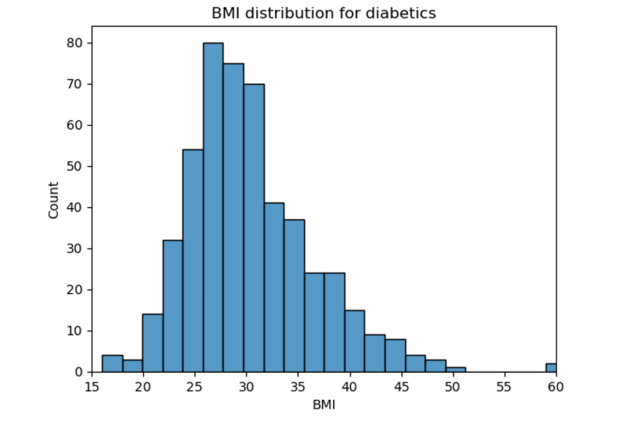
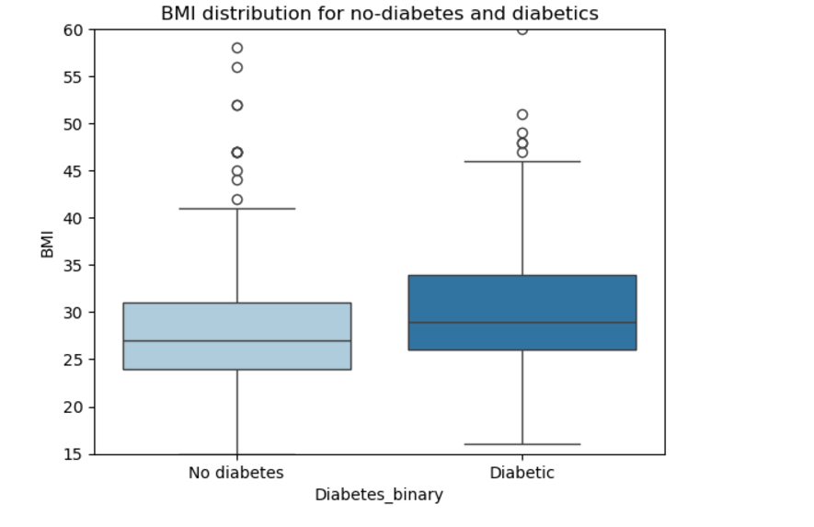
BMI
People with diabetes have a high BMI compared to non-diabetics
People with diabetes have higher BMI.

Slide 12
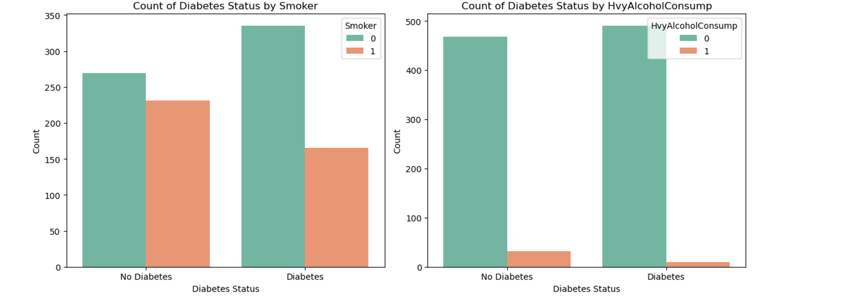
Smoking, Alcohol Consumption
Smoking and drinking are not major factors in acquiring diabetes

Slide 13
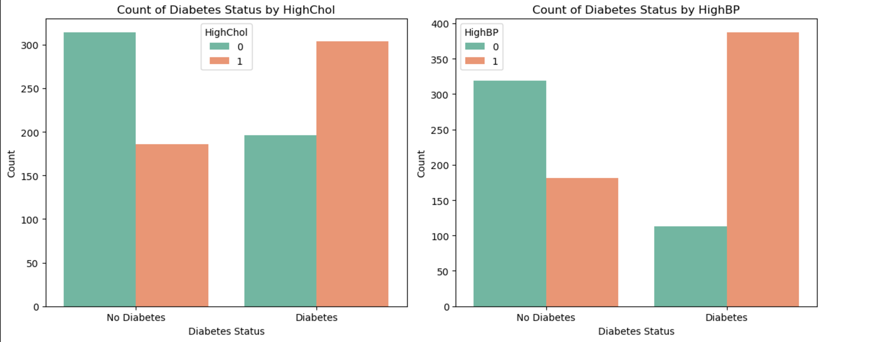
High Cholesterol, High Blood Pressure
High cholesterol and high blood pressure have a positive effect on diabetes

Slide 14
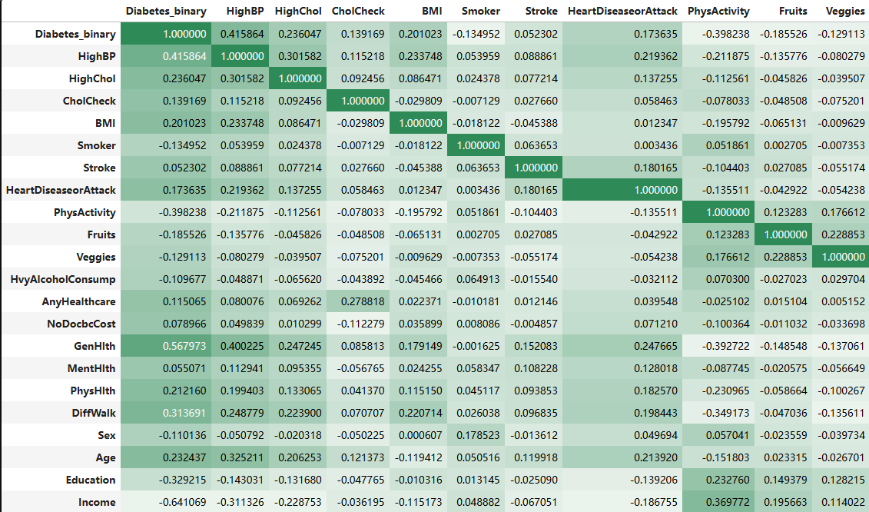
Correlation Matrix
Variables correlated with diabetes status are general health, high blood pressure, high cholesterol, BMI, difficulties in walking,Physical Heath and age.

Slide 15
03
logistic regression Model

Slide 16
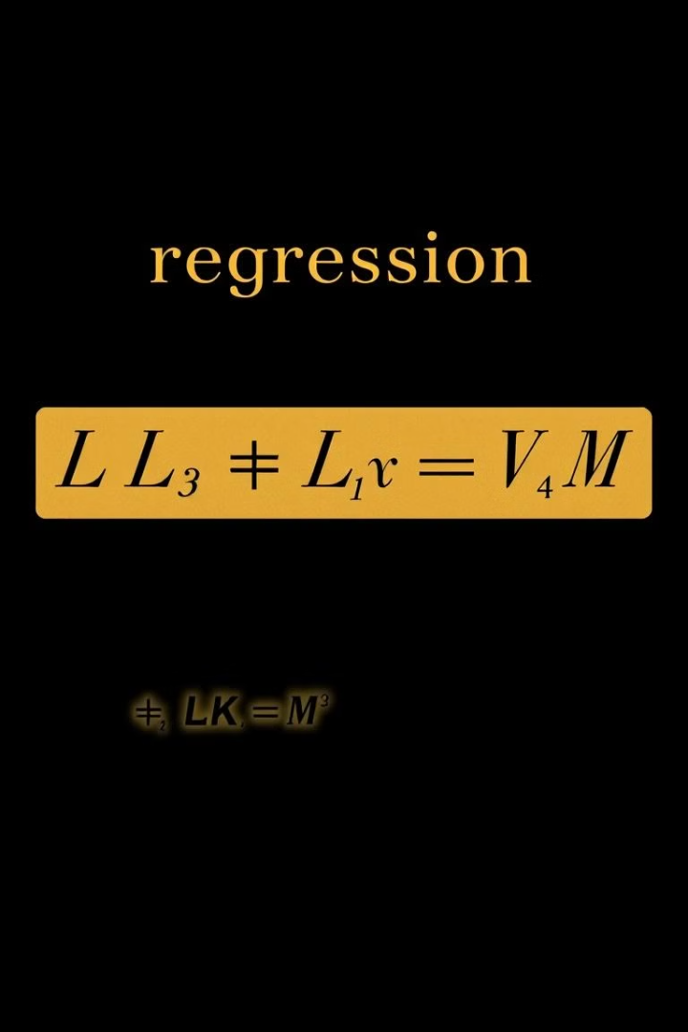

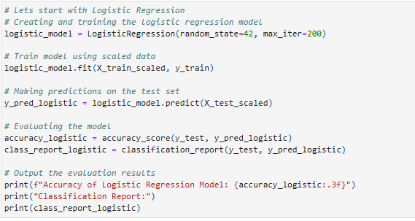
Logistic Regression Model
Linear Model
Logistic regression uses a linear function to estimate the probability of diabetes.

Slide 17
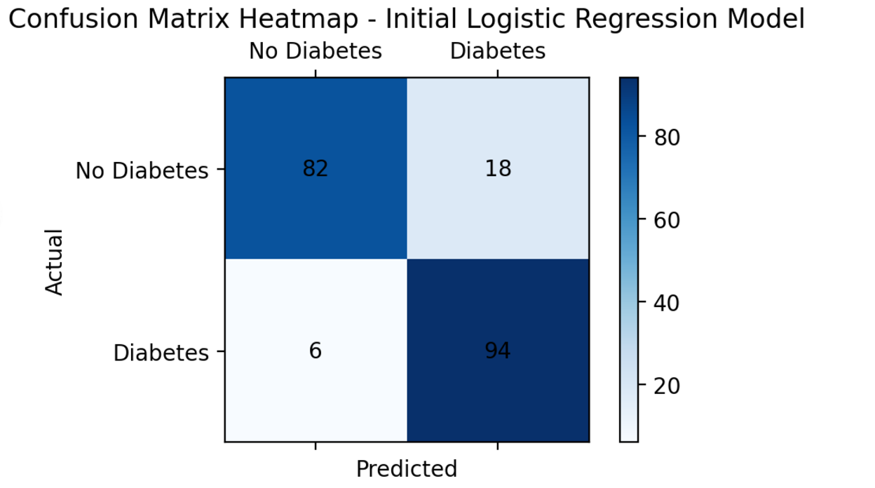
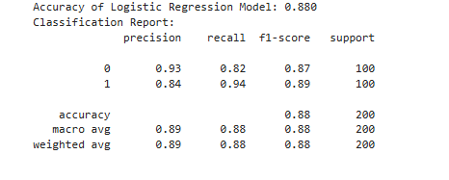
Logistic Regression Model
Confusion Matrix
logistic regression model accuracy is 0.88

Slide 18
04
SVM Model

Slide 19
SVMs are chosen for their effectiveness in high-dimensional spaces and their ability to handle non-linear decision boundaries through the use of kernel functions
Robustness: SVMs are less prone to overfitting, especially in high-dimensional spaces
Why
SVM
Flexibility: The use of different kernel functions (linear, polynomial, RBF) allows the model to capture complex relationships in the data
Optimization: Hyperparameter tuning using TPE ensures that the model parameters are optimized for the best performance

Slide 20
C | The regularization parameter of SVM
gamma | The coefficient of the kernel function The gamma parameters can be seen as the inverse of the radius of influence of samples selected by the model as support vectors.
kernel | rbf (radial basis function) poly (polynomial kernel) linear

Slide 21
Bayesian Optimization is a strategy employed for the global optimization of functions, particularly applicable to those black-box functions with exorbitant computational costs (such as the hyperparameter tuning of machine learning models).
The core concept lies in constructing a surrogate model, and gradually selecting the optimal parameters, thereby effectively attaining the global optimal solution.
Bayesian Optimization is capable of effectively exploring the parameter space without the need for substantial computational resources, and it possesses more efficient and rigorous characteristics.

Slide 22
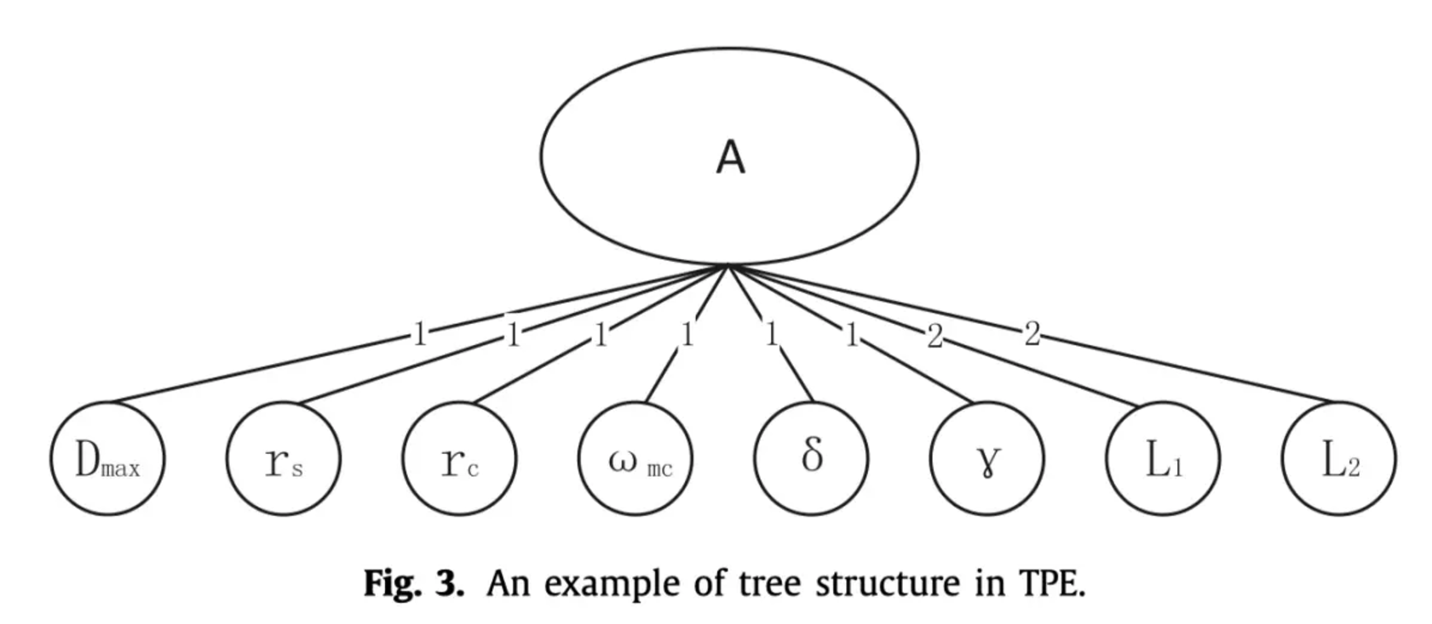
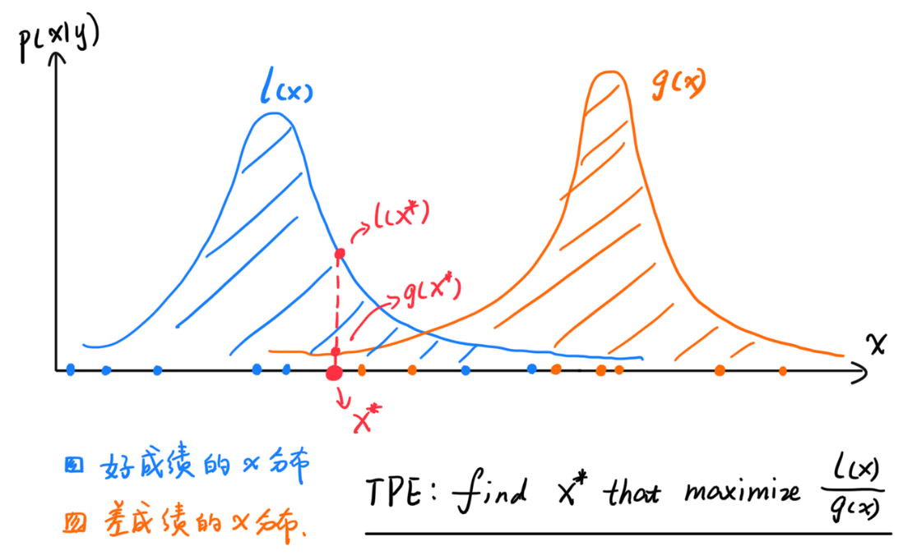
Hyperopt library | Hyperopt is a Python library for serial and parallel optimization over awkward search spaces, which may include real-valued, discrete, and conditional dimensions.
TPE algorithm | Tree-structured Parzen Estimator, being a tree-structured Bayesian optimization algorithm, is utilized to address the global optimization issues of black-box functions.

Slide 23
C | logarithmically uniformly distributed within the range of [1, 200]
gamma | logarithmically uniformly distributed within the range of [0.001, 100]
kernel | rbf (radial basis function) poly (polynomial kernel) linear

Slide 24
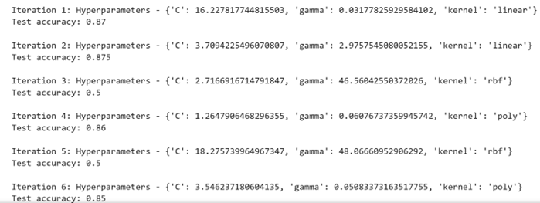
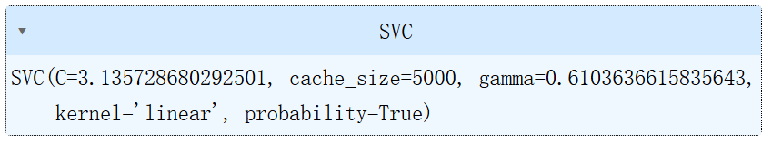

Slide 25
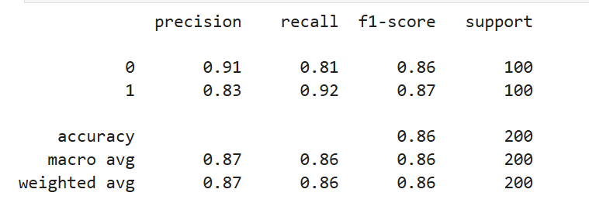
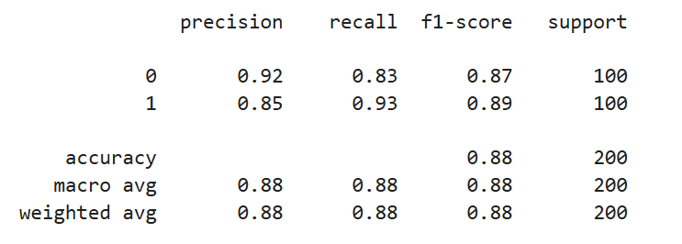
Model Performance Evaluation
88%
Accuracy
The percentage of correct predictions made by the model.
0.85
 | Accuracy | Precision | Recall
Initial Model | 0.86 | 0.83 | 0.92
Optimized Model | 0.88 | 0.85 | 0.93
Precision
The proportion of correctly predicted positive cases.
0.93
Recall
The proportion of actual positive cases correctly identified.

Slide 26
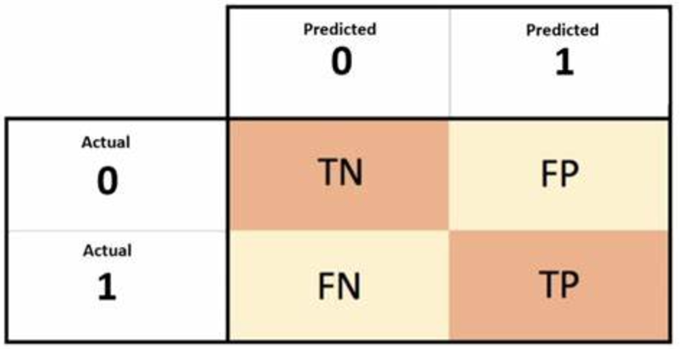
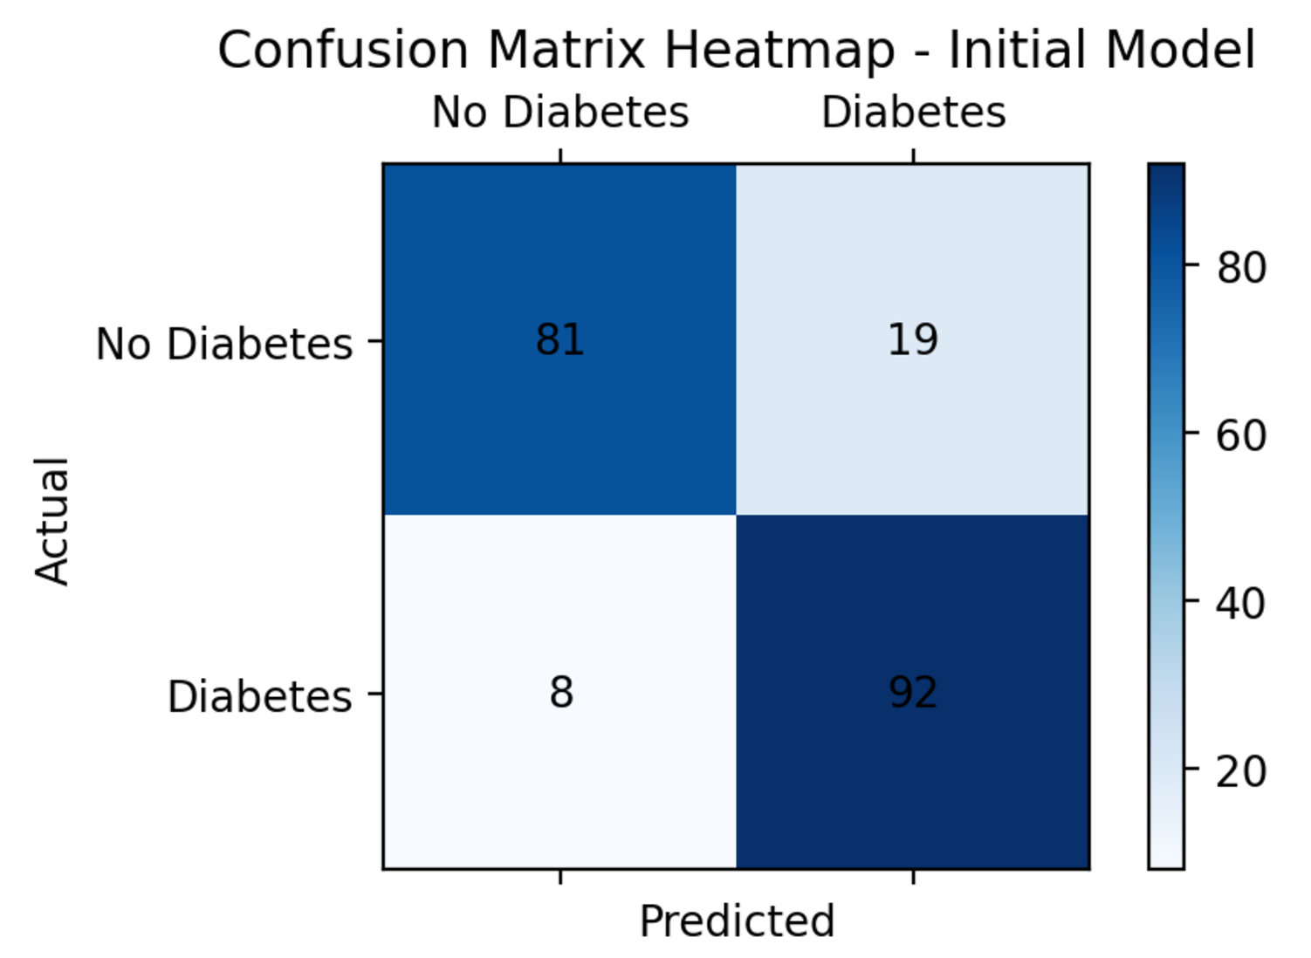
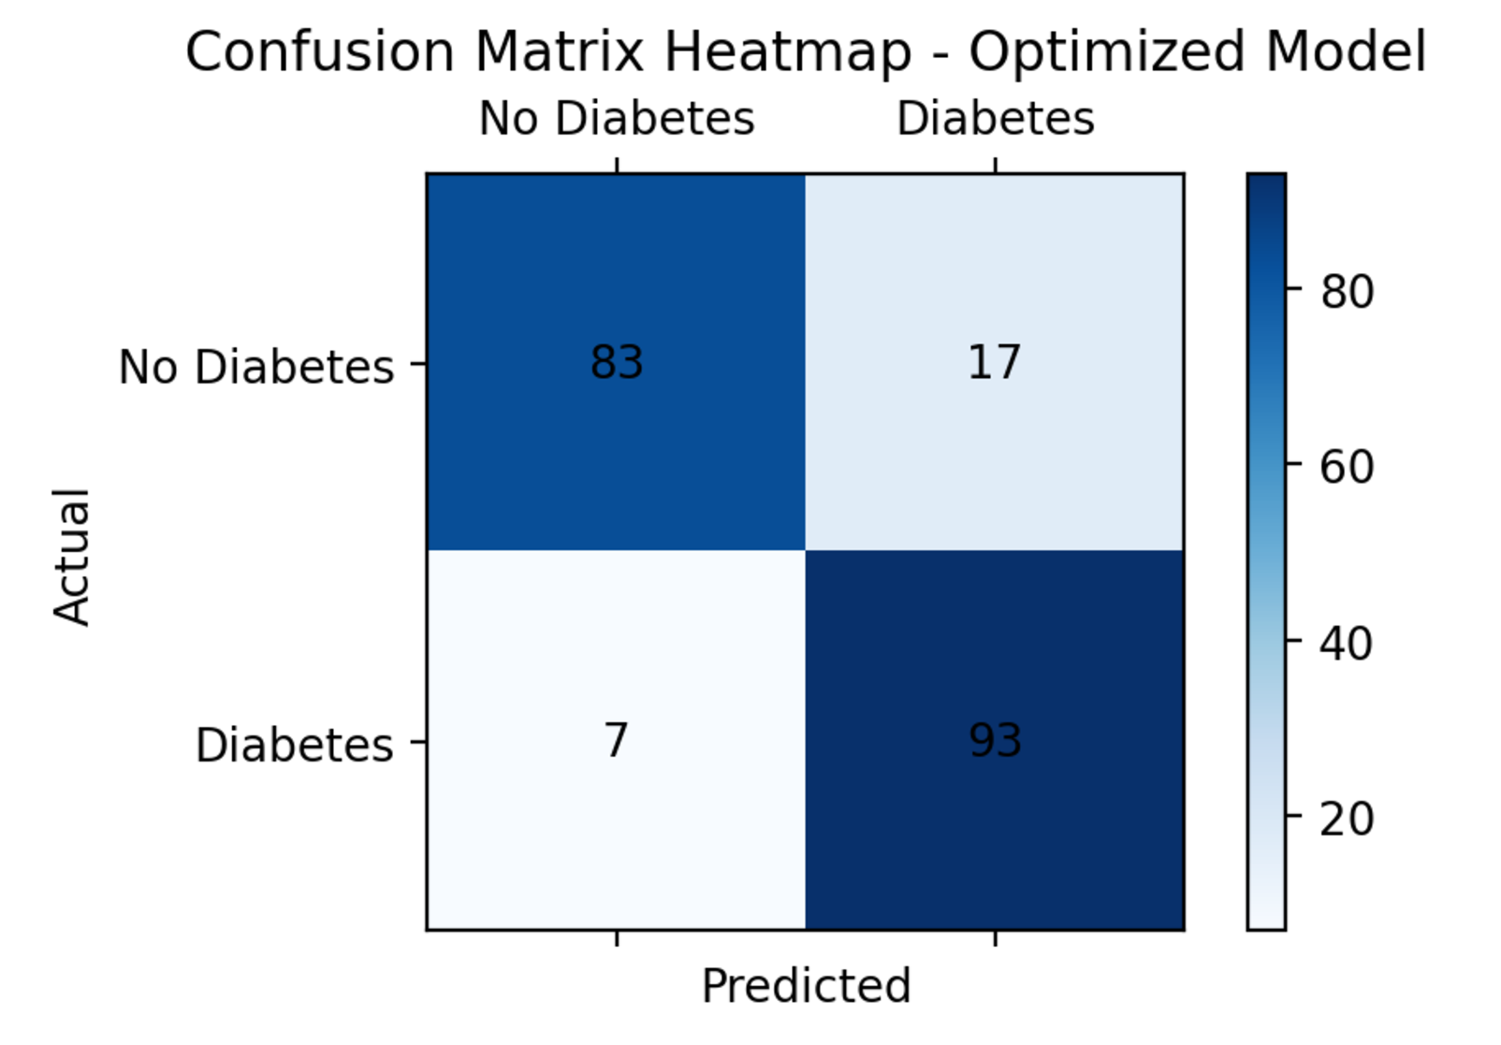
Confusion Matrix Heatmep

Slide 27
05
Random Forest
Notes:
and now lets talk about random forest part

Slide 28


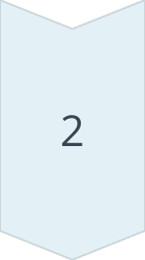
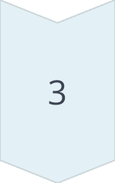
Ensemble Learning
Random forest builds an ensemble of decision trees, each trained on a random subset of the data.
Bagging and Random Subspace
The model uses bagging to create multiple datasets, and random subspace to select a random subset of features for each tree.
Majority Voting
The final prediction is made by aggregating the votes from all the individual trees.
Notes:
as we all known, the random forest is a classically powerful model. and it has three points we need to know.

Slide 29

Why Choose Random Forest
Pros:
High Accuracy
Random Forest improves model accuracy and stability by integrating multiple decision trees. It performs well on complex datasets and is usually more accurate than a single decision tree model.
Feature Importance Evaluation
Random Forest provides importance scores for each feature, helping us understand which features are most critical for diabetes prediction. This is significant for medical research and clinical decision-making.
添加内容
Preventing Overfitting
By randomly selecting features and samples to train each tree, Random Forest effectively prevents overfitting, ensuring good performance on new data.
Cons:
High Model Complexity
Comprising many decision trees, Random Forests are complex models. This complexity makes them less interpretable than single decision trees, making it harder to understand the specific impact of each feature on the final prediction.
Notes:
Random forests have some advantage such as high accuracy，feature importance evaluation，and Prevents overfitting in some extent. but in other hand its high model complexity, make it hard to interprete how it works specificly

Slide 30
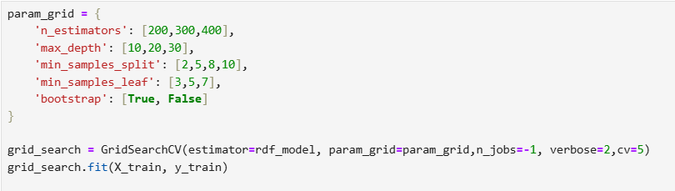
Hyperparameter optimization
n_estimators: Number of trees
max_depth: The maximum depth of the tree
min_samples_split: Minimum number of samples required to split internal nodes
min_samples_leaf: The minimum number of samples required for leaf nodes
bootstrap: Whether there is put back sampling
Notes:
and its how we optimize this model. First, we defined a parameter grid, which includes the number of trees, the maximum depth of the tree , max_depth,min_samples_split, and whether there is put - back sampling (bootstrap). Then, using the GridSearchCV function, set to use all available CPU cores, show detailed training process, and adopt 5 - fold cross - validation.

Slide 31
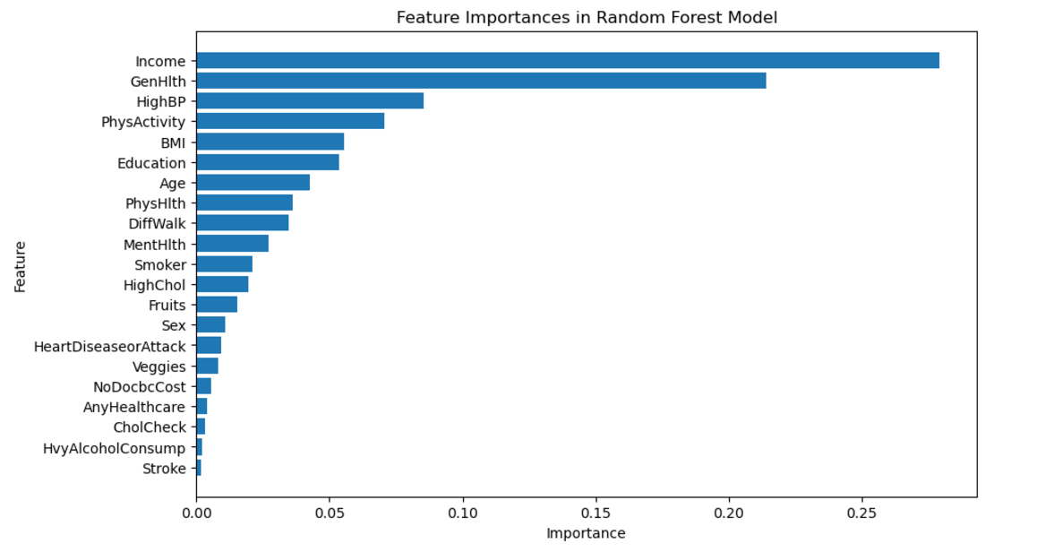
Feature Importances
Why income?
1.lifestyle choices
People with higher incomes tend to have more resources to maintain a healthy lifestyle.
2. indirect influence For example, higher income families are able to provide better educational opportunities for their children, and it is associated with health knowledge and health management skills, which in turn affects long-term health outcomes.
3. Data collection bias
Notes:
this is the feature importances from random forest. we can see that in our dataset the income become the most important feature . but why? we think the reason could be

Slide 32
06
Comparison
Notes:
and final part ,lets compare all the models

Slide 33
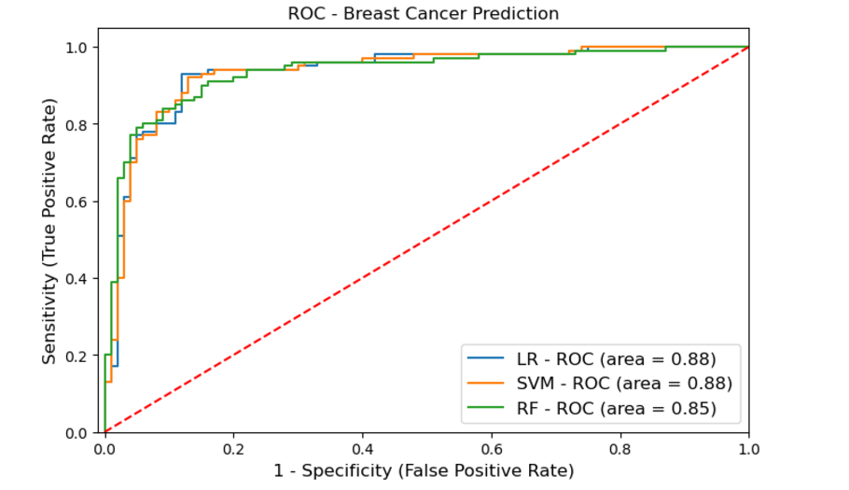
ROC Curve
Why ROC Curve?
The ROC curve does not depend on the decision threshold of the model. It can comprehensively show the performance of the model under different thresholds and is very useful for evaluating the overall discriminant ability of the model.
The area under the curve of the LR and SVM curves is basicly the same, both being 0.88, better than RF.
Notes:
firstly ，we used roc curve to compare these models.

Slide 34
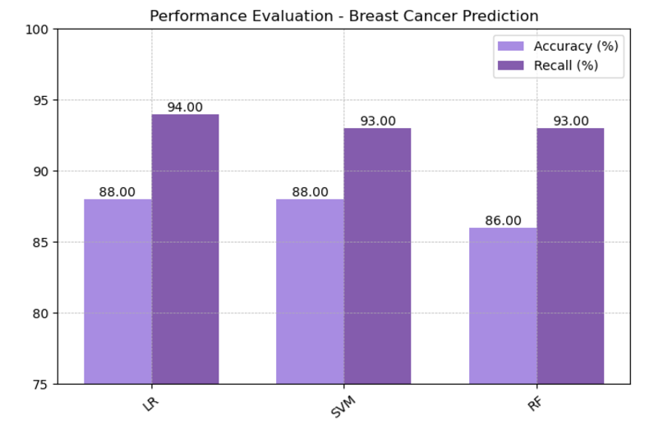
Conclusion
In terms of accuracy, Logistic Regression (LR) and Support Vector Machine (SVM) perform slightly better, while Random Forest (RF) is slightly inferior.
In terms of recall, the Logistic Regression (LR) performs the best, Overall, Logistic Regression is the best model for our project, which the accuracy is 88% and the recall is 93%.
Notes:
so we use accuracy and recall to further comparison.

Slide 35
Thank you for listening

